Slide 1
Lesson 11
Creating Functions

Slide 2
Objective
After completing this lesson, you should be able to:
  Differentiate between a procedure and a function
  Describe the uses of functions
  Create stored functions
  Invoke a function
  Remove a function
  Explain the basic functionality of the SQL Developer debugger

Slide 3
Lesson Agenda
  Creating and invoking functions
  Functions in SQL expressions
  Passing parameters to functions
  Removing stored functions

Slide 4
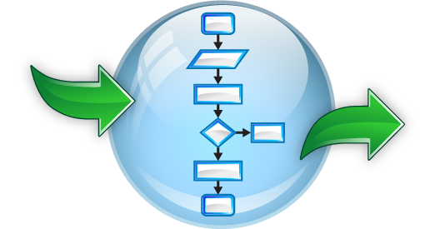
Functions
  Named PL/SQL block like procedure
  Accepts input as parameters
  Processes the input and returns a value
  Stored as a database object
  Enables modularization in the application
  Can be invoked as part of an expression

Slide 5
Creating Functions syntax
The PL/SQL block must have at least one RETURN statement.
CREATE [OR REPLACE] FUNCTION function_name
[(parameter1 [mode1] datatype1, . . .)]
RETURN datatype IS|AS
[local_variable_declarations;
. . .]
BEGIN
-- actions;
RETURN expression;
END [function_name];

Slide 6



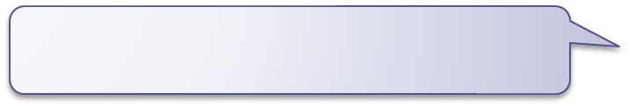
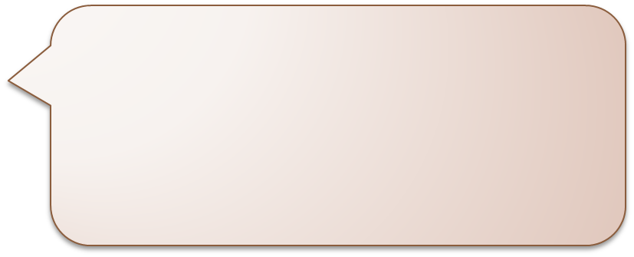

Tax Calculation
I could update the database with the promotions and salary raise. Thanks Alice. Now I need your help in calculating the tax applicable for each employee.
Sure, tell me the formula for calculation.
I will mail you the formula. It’s a bit complicated. The code you write should help me in arriving at a value based on input. It should be good to use in mathematical formulas. I may have to calculate taxes in many places.
Got it

Slide 7
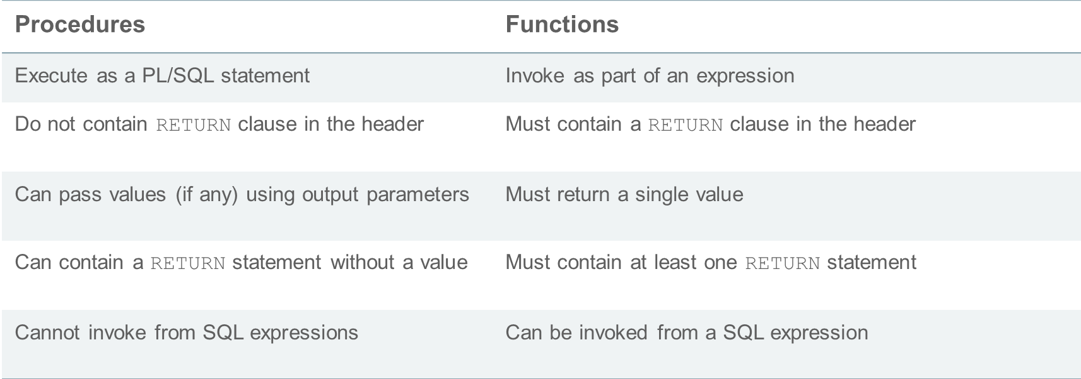

The Difference Between Procedures and Functions

Slide 8





Creating Functions: Overview
/
YES
Create/edit procedure
Compiler
warnings/errors?
View compiler
warnings/errors
NO
Execute procedure

Slide 9
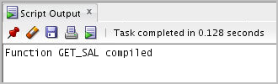
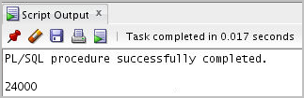
Invoking a Stored Function: Example
CREATE OR REPLACE FUNCTION get_sal
(p_id employees.employee_id%TYPE) RETURN NUMBER IS
v_sal employees.salary%TYPE := 0;
BEGIN
SELECT salary
INTO v_sal
FROM employees
WHERE employee_id = p_id;
RETURN v_sal;
END get_sal;
/
-- Invoke the function as an expression or as
-- a parameter value.
EXECUTE dbms_output.put_line(get_sal(100))

Slide 10
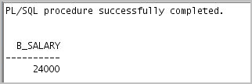

Using Different Methods for Executing Functions
-- As a PL/SQL expression, get the results using host variables
VARIABLE b_salary NUMBER
EXECUTE :b_salary := get_sal(100)
-- As a PL/SQL expression, get the results using a local
-- variable
SET SERVEROUTPUT ON
DECLARE
sal employees.salary%type;
BEGIN
sal := get_sal(100);
DBMS_OUTPUT.PUT_LINE('The salary is: '|| sal);
END;
/

Slide 11
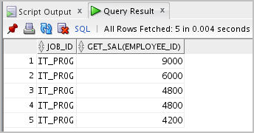
Using Different Methods for Executing Functions
-- Use as a parameter to another subprogram
EXECUTE dbms_output.put_line(get_sal(100))
-- Use in a SQL statement (subject to restrictions)
SELECT job_id, get_sal(employee_id)
FROM employees
WHERE department_id = 60;

Slide 12


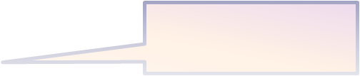
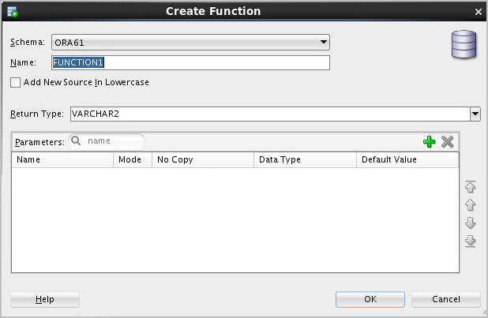
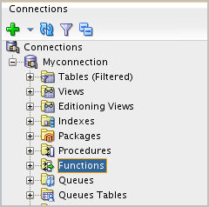
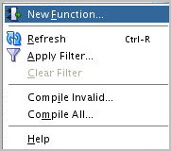


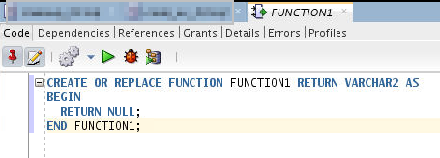
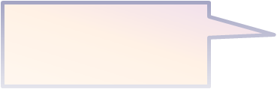
Creating and Compiling Functions Using SQL Developer
3
1
2
Change function name
Compile
4
Write function code

Slide 13
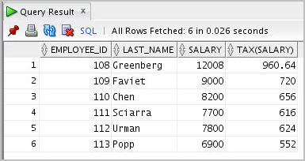
Using a Function in a SQL Expression: Example
CREATE OR REPLACE FUNCTION tax(p_id IN employees.employee_id%type)
RETURN NUMBER IS
v_sal employees.salary%type;
BEGIN
select salary into v_sal
from employees
where employee_id = p_id;
RETURN (v_sal * 0.08);
END tax;
/
SELECT employee_id, last_name, salary, tax(employee_id)
FROM employees
WHERE department_id = 100;

Slide 14
Calling User-Defined Functions in SQL Statements
User-defined functions act like built-in single-row functions and can be used in:
  The SELECT list or clause of a query
  Conditional expressions of the WHERE and HAVING clauses
  The ORDER BY and GROUP BY clauses of a query
  The VALUES clause of the INSERT statement
  The SET clause of the UPDATE statement

Slide 15
Restrictions When Calling Functions from SQL Expressions
  User-defined functions that are callable from SQL expressions must:
    Be stored in the database
    Accept only IN parameters with valid SQL data types and PL/SQL-specific data types
    Return valid SQL data types and PL/SQL-specific data types
  When calling functions in SQL statements:
    Be the owner of the function
    Have the EXECUTE privilege
    Enable the PARALLEL_ENABLE option in function specification

Slide 16


Side Effects of Function Execution
A subprogram may have side effects when it performs one of the following operations:
  Updates its own OUT or IN OUT parameter
  Modifies a global variable
  Modifies a public variable in a package
  Updates a database table
  Modifies the database

Slide 17
Guidelines to Control Side Effects
Functions called from:
  A SELECT statement cannot contain DML statements
  An UPDATE or DELETE statement on a table T cannot query or contain DML on the same table T
  SQL statements cannot end transactions (that is, cannot execute COMMIT or ROLLBACK operations)
Note: Calls to subprograms that break these restrictions are not allowed in the function

Slide 18
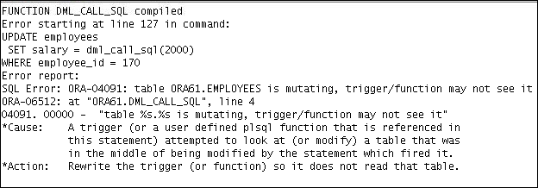
Controlling Side Effects
CREATE OR REPLACE FUNCTION dml_call_sql(p_sal NUMBER)
RETURN NUMBER IS
BEGIN
INSERT INTO employees(employee_id, last_name,
email, hire_date, job_id, salary)
VALUES(1, 'Frost', 'jfrost@company.com',
SYSDATE, 'SA_MAN', p_sal);
RETURN (p_sal + 100);
END;
UPDATE employees
SET salary = dml_call_sql(2000)
WHERE employee_id = 170;

Slide 19

Passing Parameters to Functions
Functions accept :
  Named parameters
  Positional parameters
  Mixed parameters
Let us see a variant of the tax function. This new function would accept the employee_id and nontaxable allowances as input parameters and calculate the tax applicable for the employee. The nontaxable allowances per month has to be deducted from the salary and tax has to be calculated on the remaining amount.

Slide 20
Named and Mixed Notation from SQL: Example
CREATE OR REPLACE FUNCTION tax_new(p_id IN employees.employee_id%type,
p_allowances NUMBER default 500)
RETURN NUMBER IS
v_sal employees.salary%type;
BEGIN
select salary into v_sal
from employees
where employee_id = p_id;
v_sal := v_sal-p_allowances;
RETURN (v_sal * 0.08);
END tax_new;
EXECUTE DBMS_OUTPUT.PUT_LINE(tax_new(100));
EXECUTE DBMS_OUTPUT.PUT_LINE(tax_new(100,1500));
EXECUTE DBMS_OUTPUT.PUT_LINE(tax_new(p_allowances =>1500, p_id=>100));
EXECUTE DBMS_OUTPUT.PUT_LINE(tax_new(p_id=>100));

Slide 21
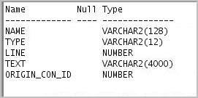
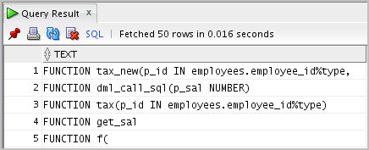
Viewing Functions Using Data Dictionary Views
DESCRIBE USER_SOURCE
SELECT text
FROM user_source
WHERE type = 'FUNCTION'
ORDER BY line;

Slide 22
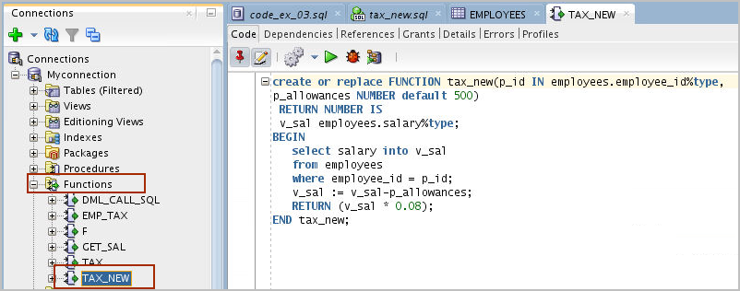

Viewing Functions Information Using SQL Developer
1
2

Slide 23


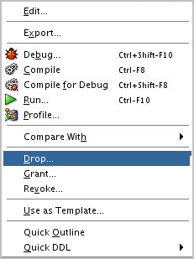

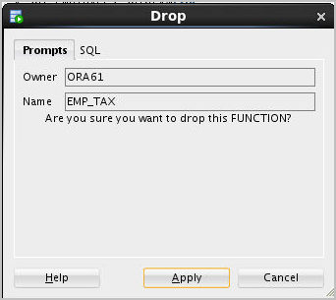
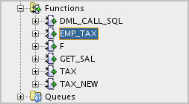
Removing Functions: Using the DROP
SQL Statement or SQL Developer
  Using the DROP statement:
  DROP FUNCTION function_name;
  Using SQL Developer:
1
2
3

Slide 24
Quiz
Which of the following statements are true about a PL/SQL stored function?
  Can be invoked as part of an expression
  Must contain a RETURN clause in the header
  Must return a single value
  Must contain at least one RETURN statement
  Does not contain a RETURN clause in the header

Slide 25
Summary
In this lesson, you should have learned how to:
  Differentiate between a procedure and a function
  Describe the uses of functions
  Create stored functions
  Invoke a function
  Remove a function
  Explain the basic functionality of the SQL Developer debugger

